Slide 1
Image Caption Metrics

Slide 2
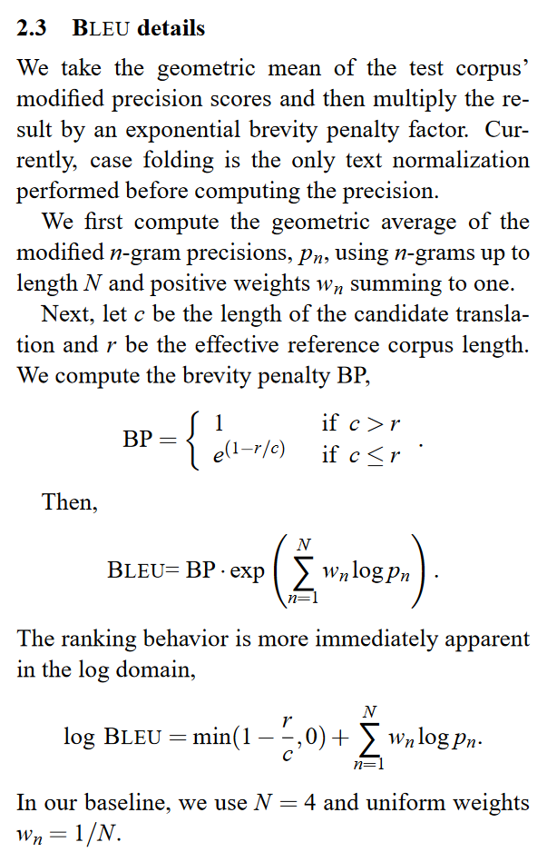
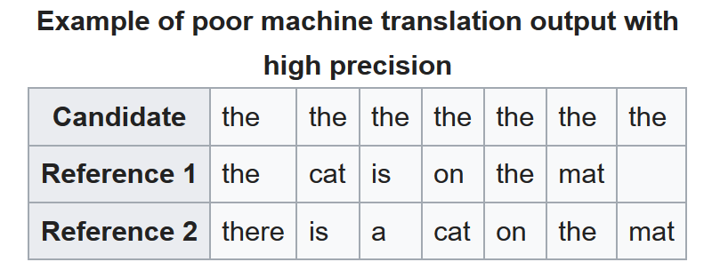
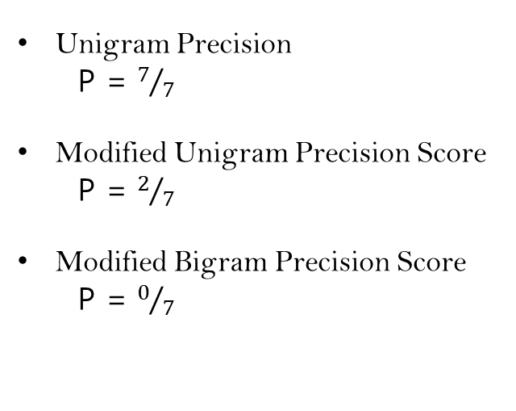
BLEU : Bi-Lingual Evaluation Understudy
BLEU (bilingual evaluation understudy) is an algorithm for evaluating the quality of text which has been machine-translated from one natural language to another.
Performance
It has been argued that although BLEU has significant advantages, there is no guarantee that an increase in BLEU score is an indicator of improved translation quality. There is an inherent, systemic problem with any metric based on comparing with one or a few reference translations: in real life, sentences can be translated in many different ways, sometimes with no overlap. Therefore, the approach of comparing by how much a computer translation differs from just a few human translations is flawed.
Unigram Precision
P = $7/7$
Modified Unigram Precision Score
P = $2/7$
Modified Bigram Precision Score
P = $0/7$
https://www.aclweb.org/anthology/P02-1040.pdf

Slide 3
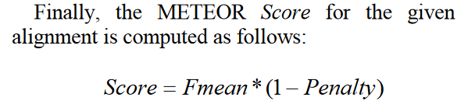
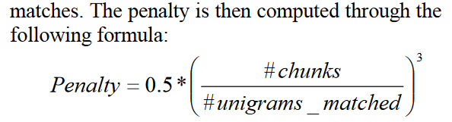
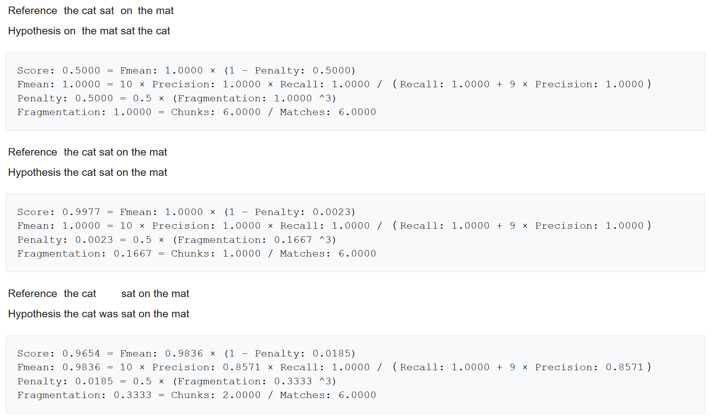
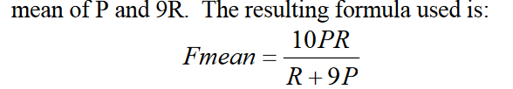
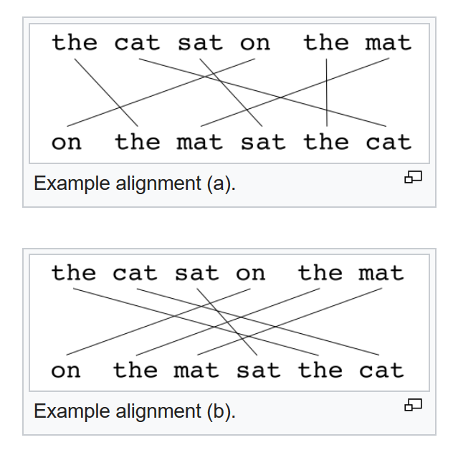
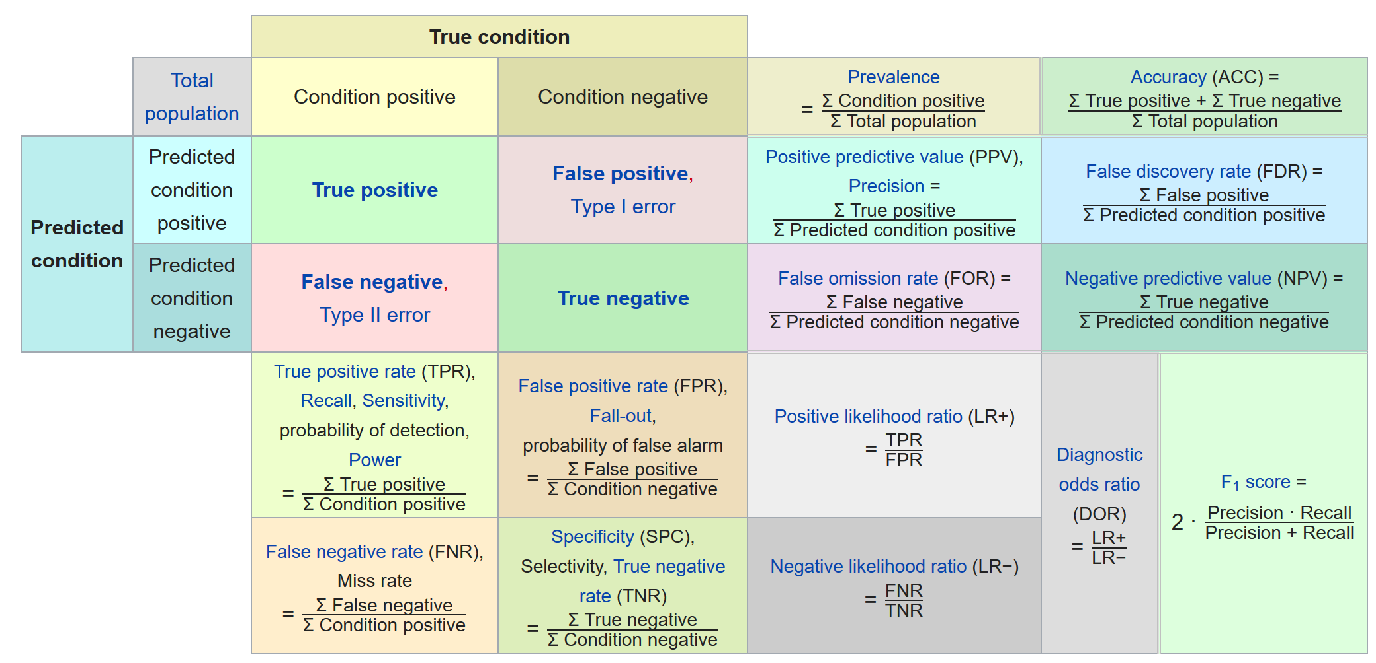
METEOR : Metric for Evaluation of Translation with Explicit ORdering
The measures that have been introduced so far only account for congruity with respect to single words but not with respect to larger segments that appear in both the reference and the candidate sentence. In order to compute this penalty, unigrams are grouped into the fewest possible chunks, where a chunk is defined as a set of unigrams that are adjacent in the hypothesis and in the reference. The longer the adjacent mappings between the candidate and the reference, the fewer chunks there are. A translation that is identical to the reference will give just one chunk.
https://www.aclweb.org/anthology/W05-0909.pdf

Slide 4
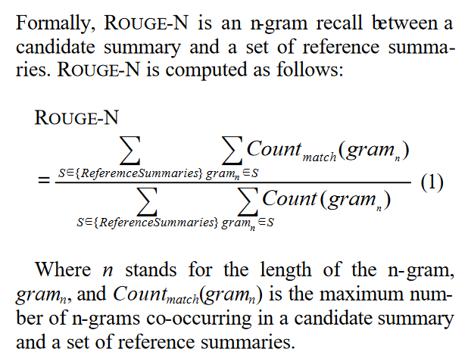
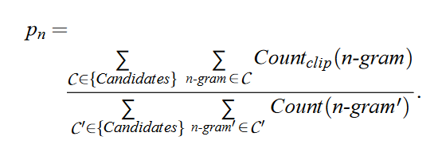
ROUGE : Recall-Oriented Understudy for Gisting Evaluation
BLEU : Bi-Lingual Evaluation Understudy(n-gram precision)
The metrics(rouge) compare an automatically produced summary or translation against a reference or a set of references (human-produced) summary or translation.
The following five evaluation metrics are available.
ROUGE-N: Overlap of N-grams between the system and reference summaries.
ROUGE-1 refers to the overlap of unigram (each word) between the system and reference summaries.
ROUGE-2 refers to the overlap of bigrams between the system and reference summaries.
ROUGE-L: Longest Common Subsequence (LCS) based statistics. Longest common subsequence problem takes into account sentence level structure similarity naturally and identifies longest co-occurring in sequence n-grams automatically.
ROUGE-W: Weighted LCS-based statistics that favors consecutive LCSes.
ROUGE-S: Skip-bigram based co-occurrence statistics. Skip-bigram is any pair of words in their sentence order.
ROUGE-SU: Skip-bigram plus unigram-based co-occurrence statistics.
https://www.aclweb.org/anthology/W04-1013.pdf

Slide 5
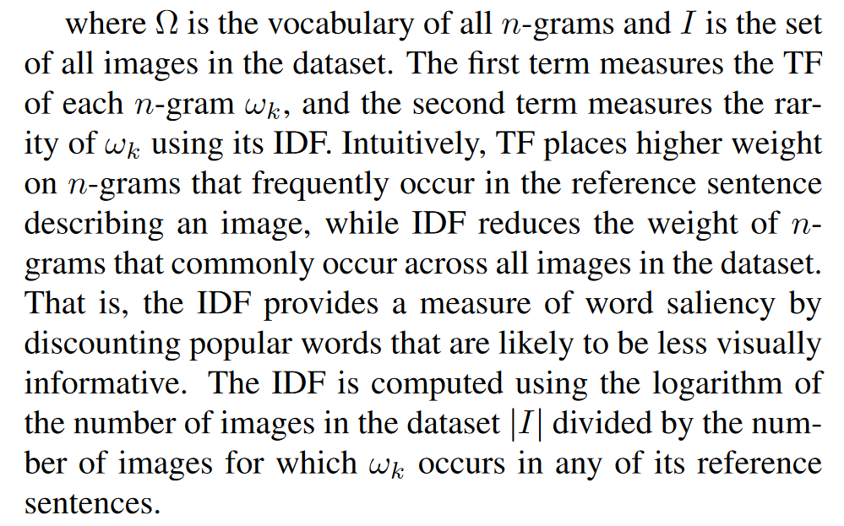
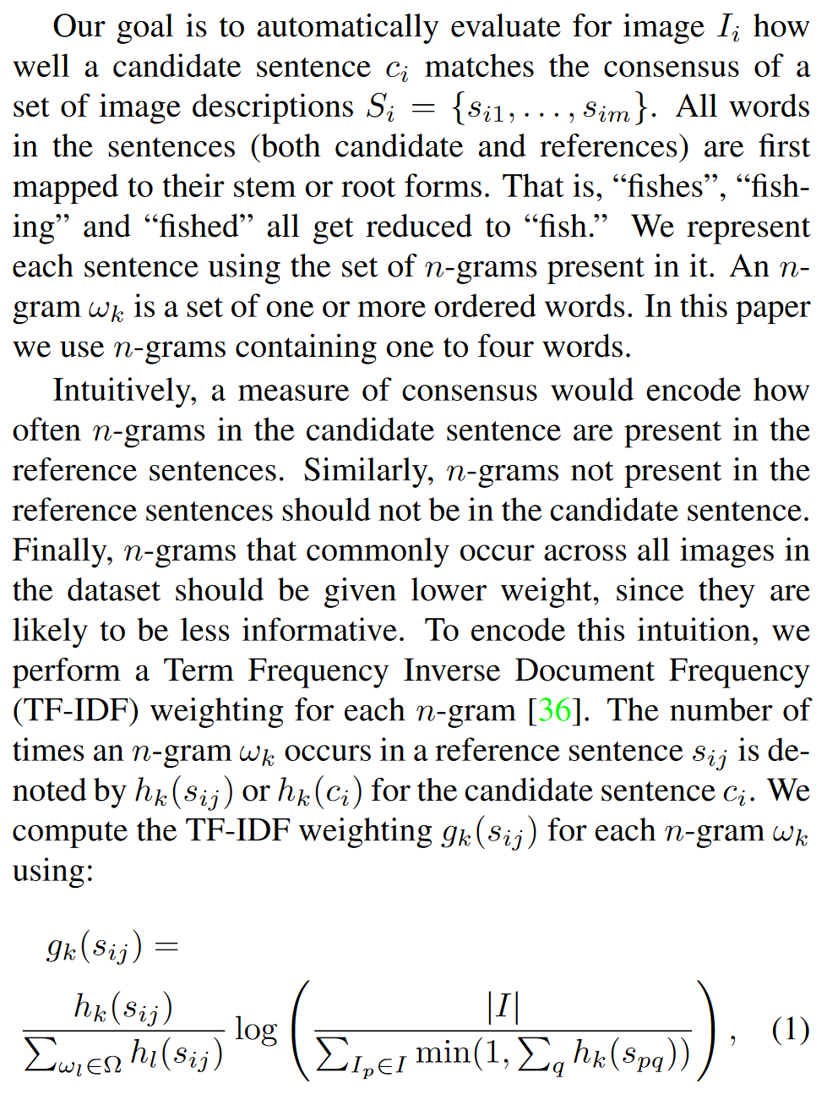
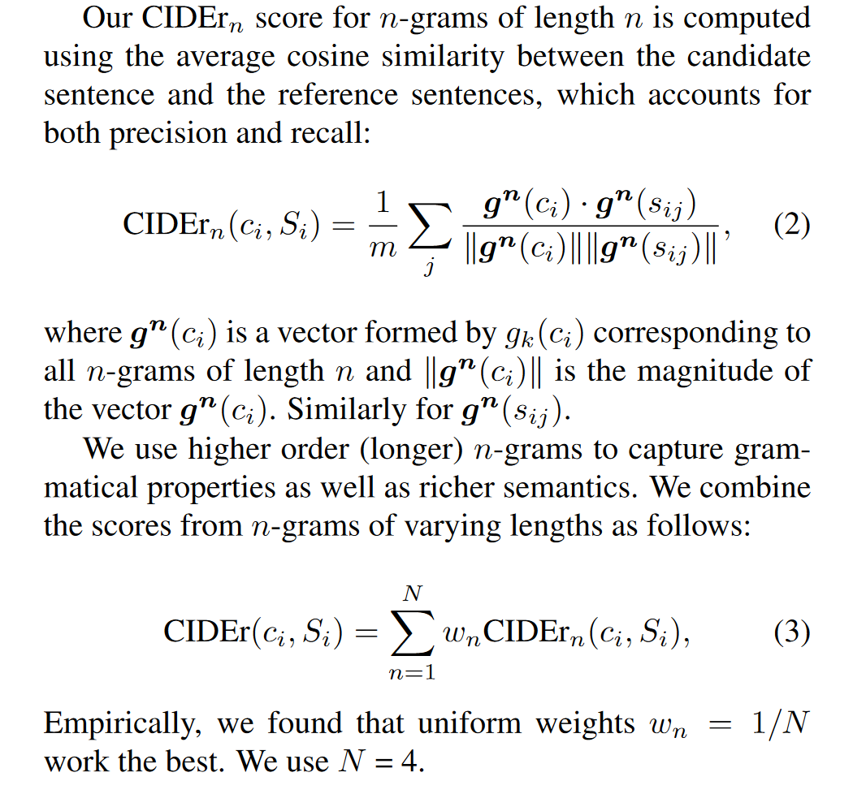
CIDEr : Consensus-based Image Description Evaluation
In information retrieval, tf–idf or TFIDF, short for term frequency–inverse document frequency, is a numerical statistic that is intended to reflect how important a word is to a document in a collection or corpus.
In the case of the term frequency tf(t,d), the simplest choice is to use the raw count of a term in a document, i.e., the number of times that term t occurs in document d.
The inverse document frequency is a measure of how much information the word provides, i.e., if it's common or rare across all documents.
Intuitively, words present across all caption is less informative, thus should be given less weight in evaluation of similarity.
Inverse Document Frequency
Term Frequency
https://arxiv.org/abs/1411.5726

Slide 6
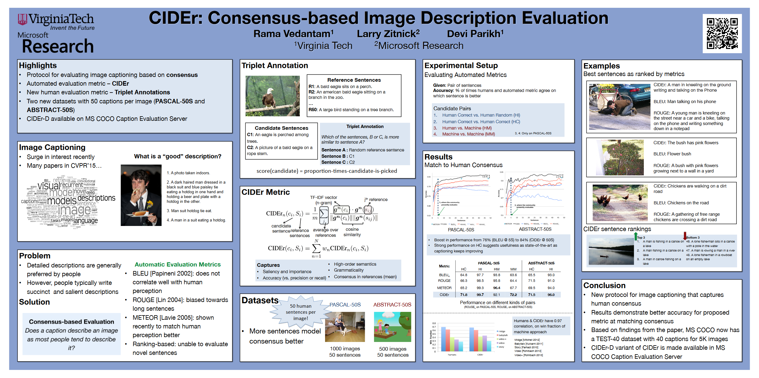
https://filebox.ece.vt.edu/~vrama91/CIDEr_miscellanous/ciderPosterCVPR15.pdf

Slide 7
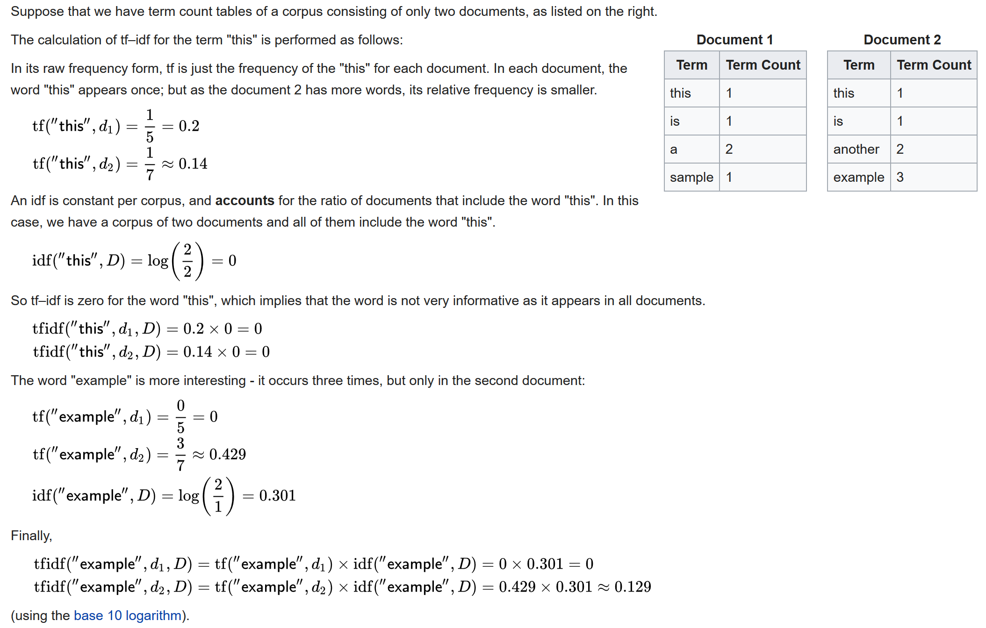
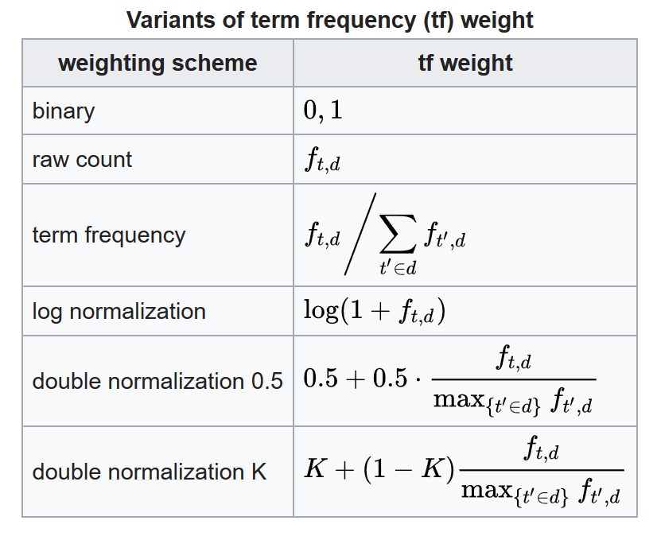
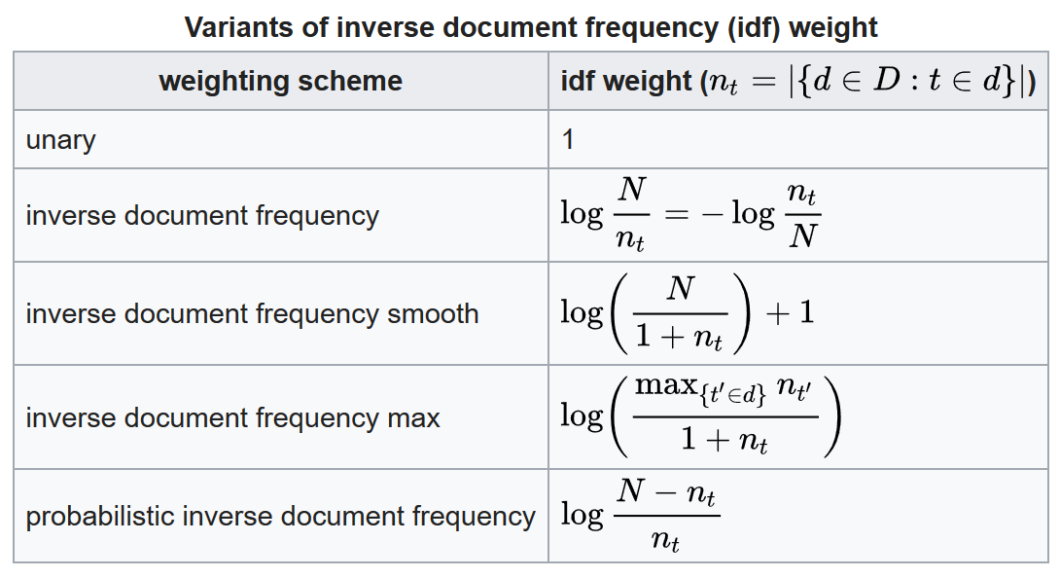
Example of tf–idf
https://en.wikipedia.org/wiki/Tf%E2%80%93idf

Slide 8
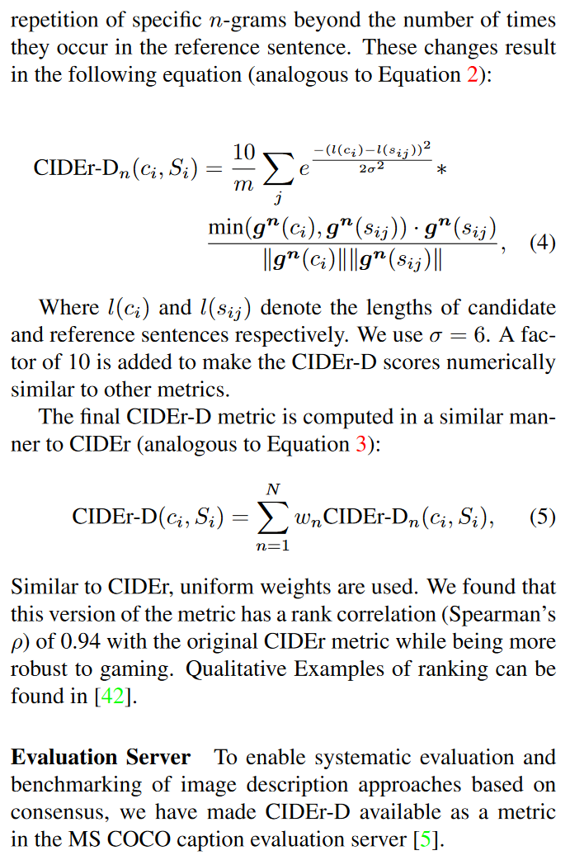
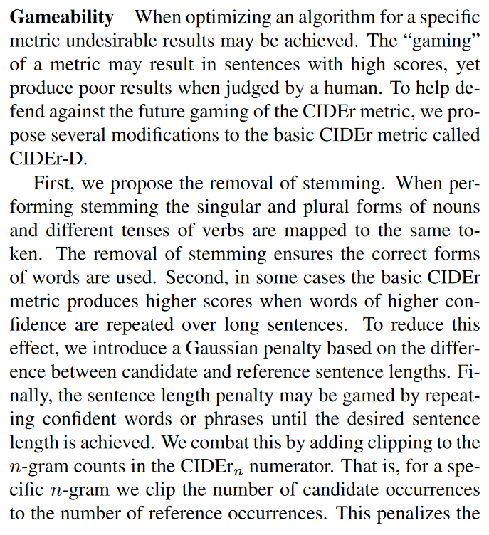
CIDEr-D

Slide 9
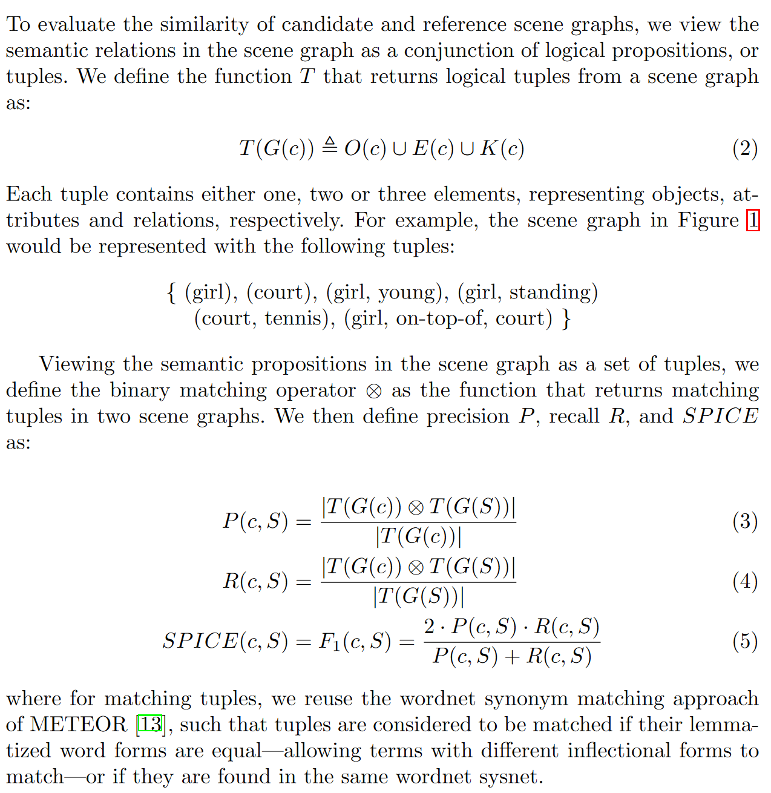
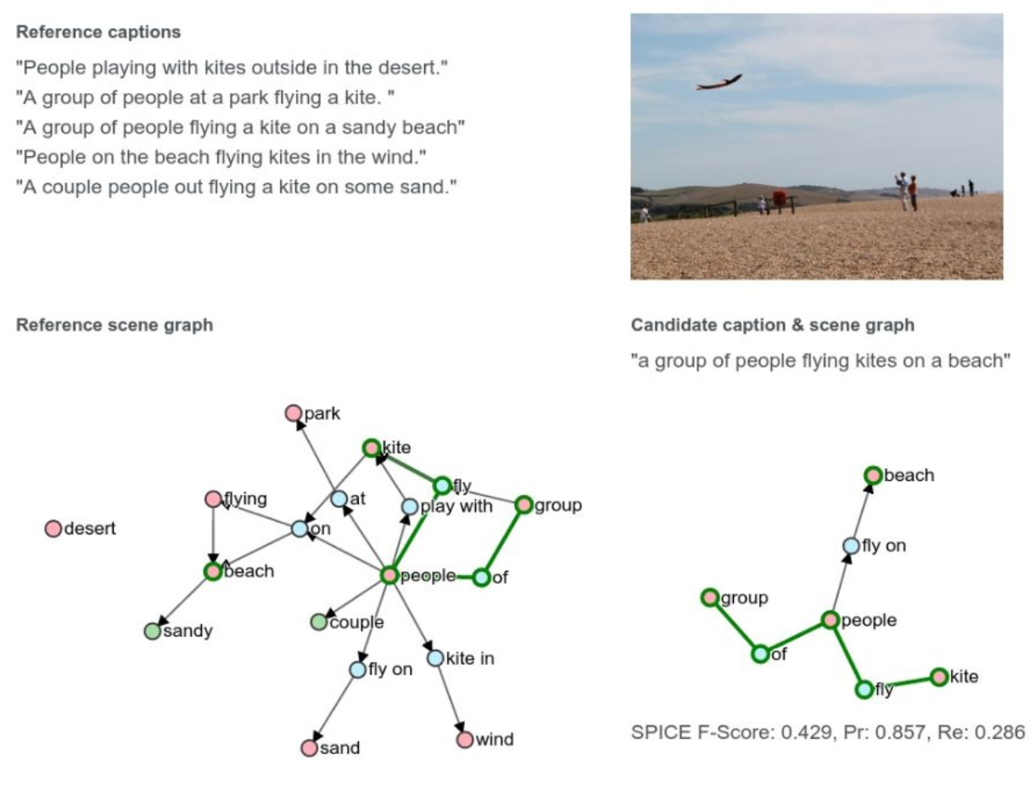
SPICE : Semantic Propositional Image Caption Evaluation
https://arxiv.org/abs/1607.08822

Slide 10
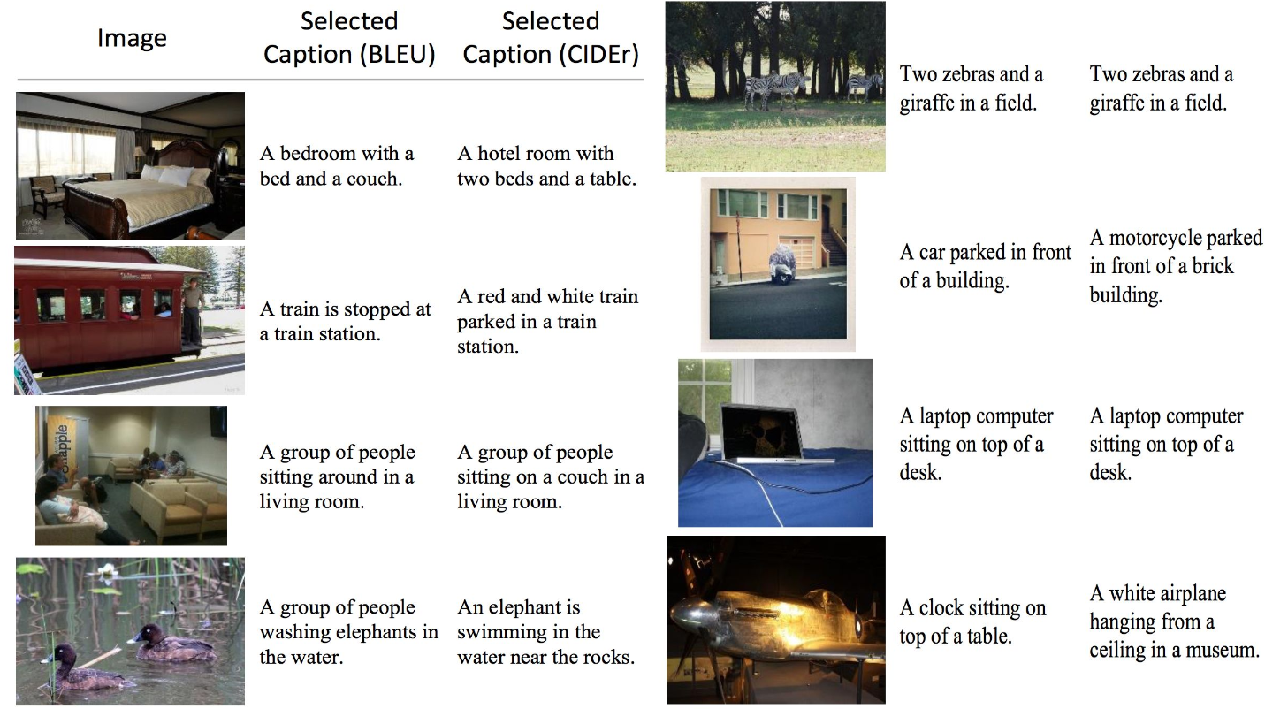
Similarity Measures
https://www.cs.princeton.edu/courses/archive/spring18/cos598B/public/outline/Towards%20image%20captioning.pdf

Slide 11
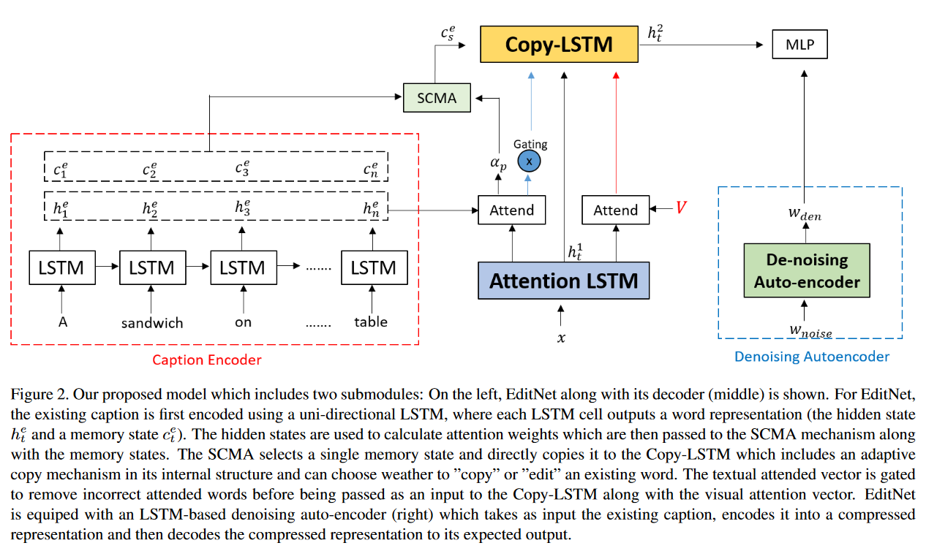
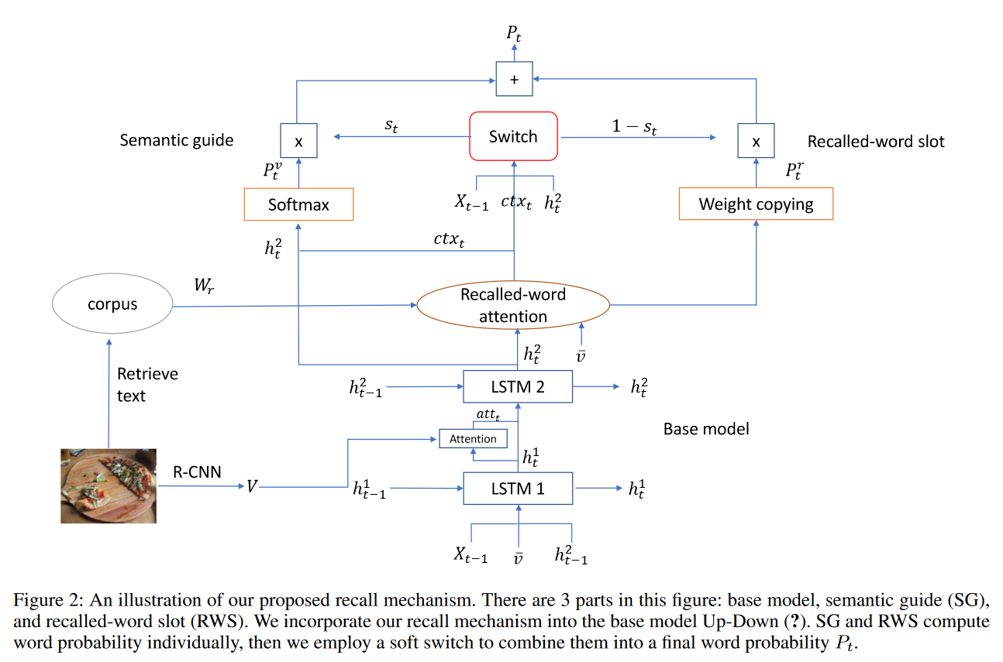
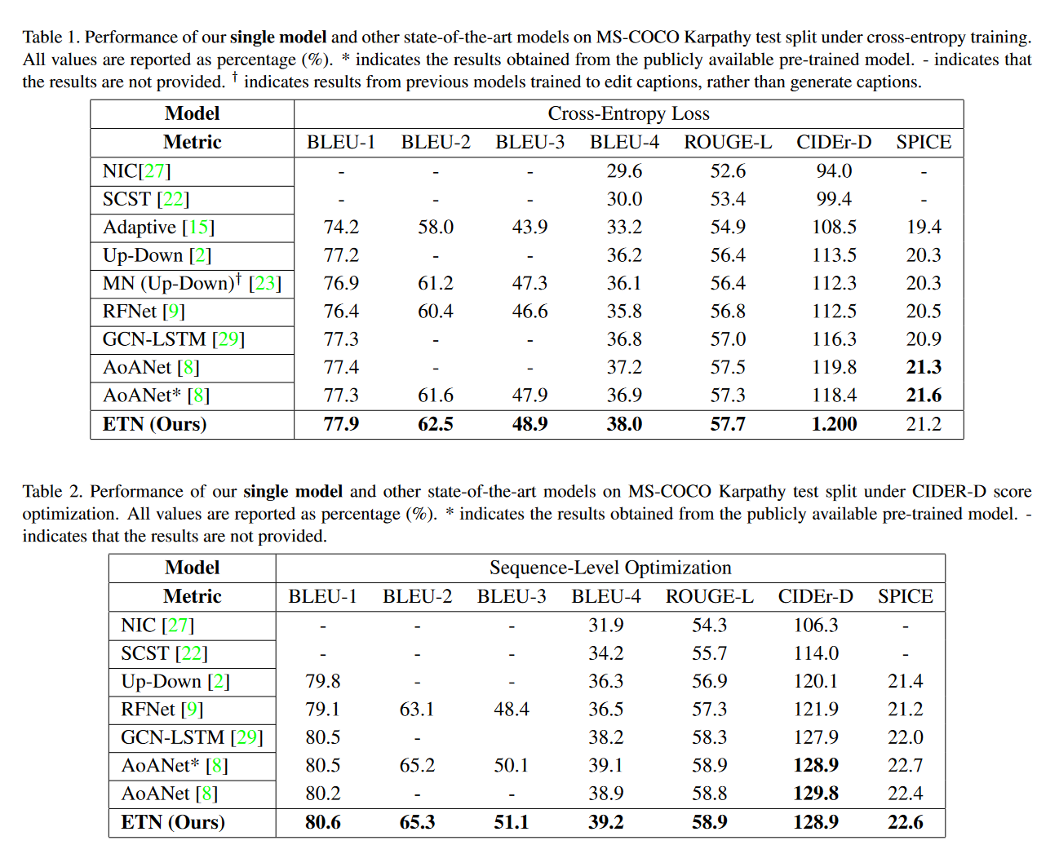
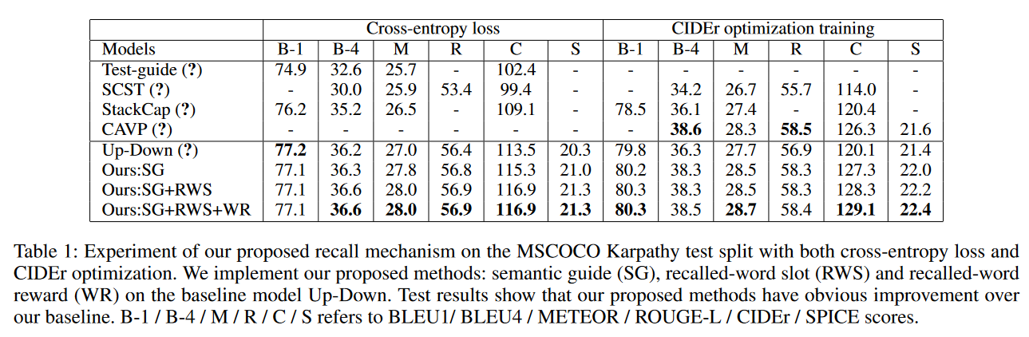
Edit vs Recall

Slide 12
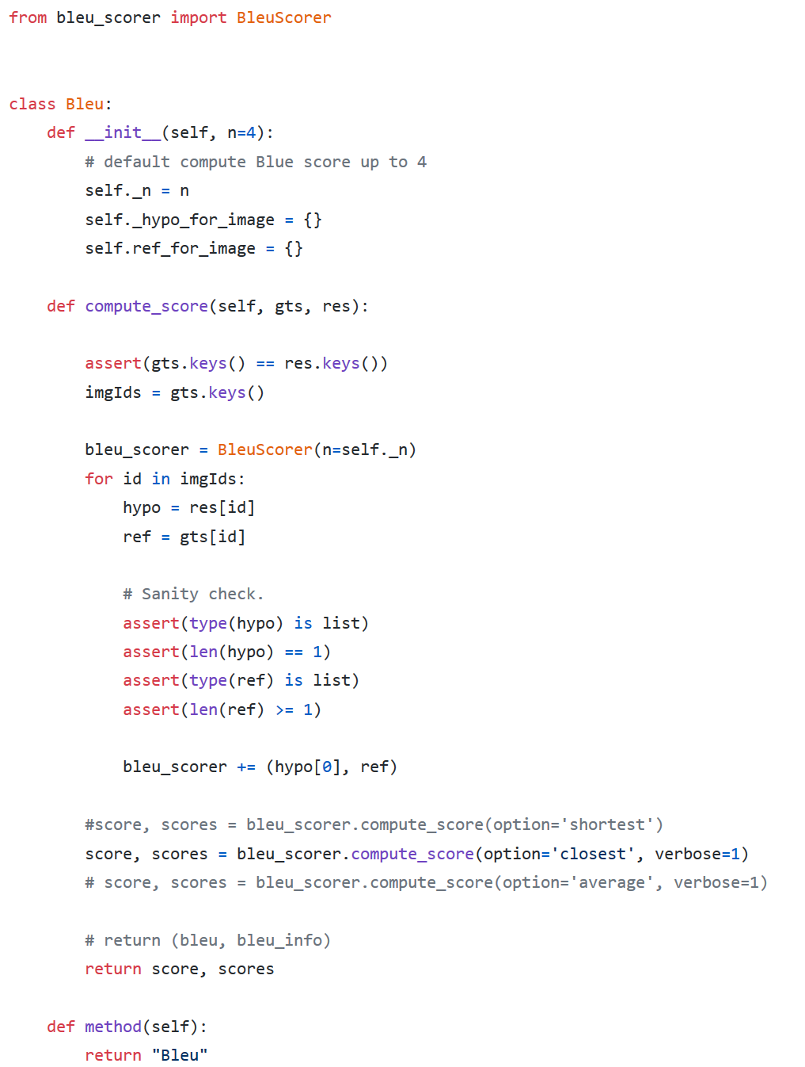
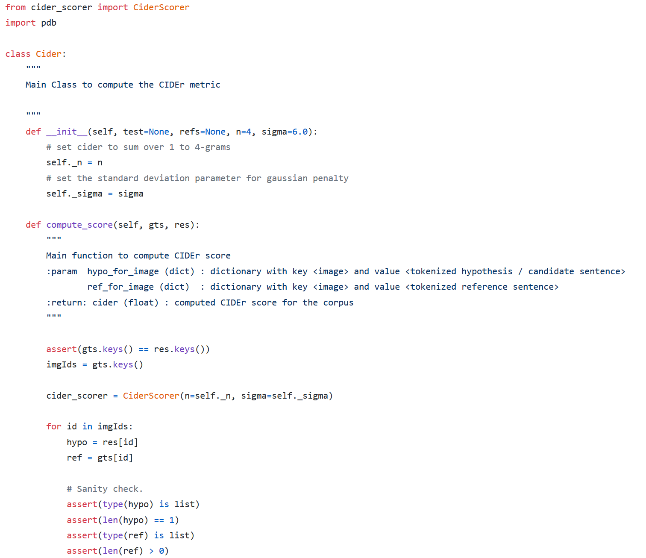
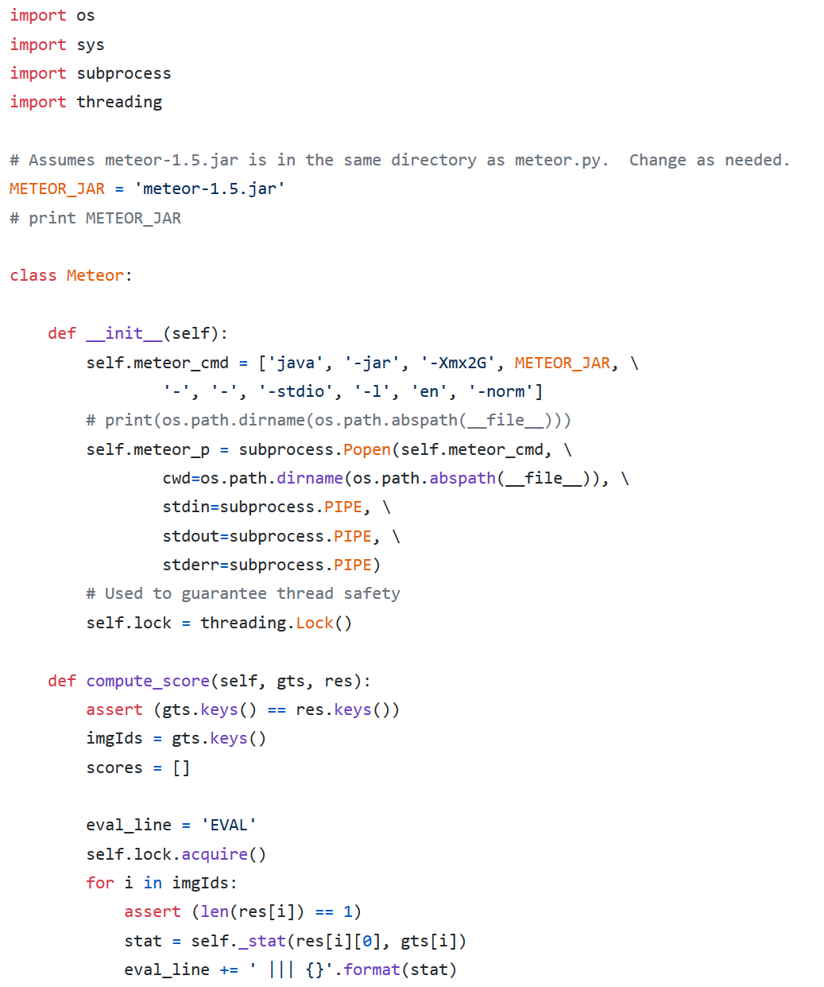
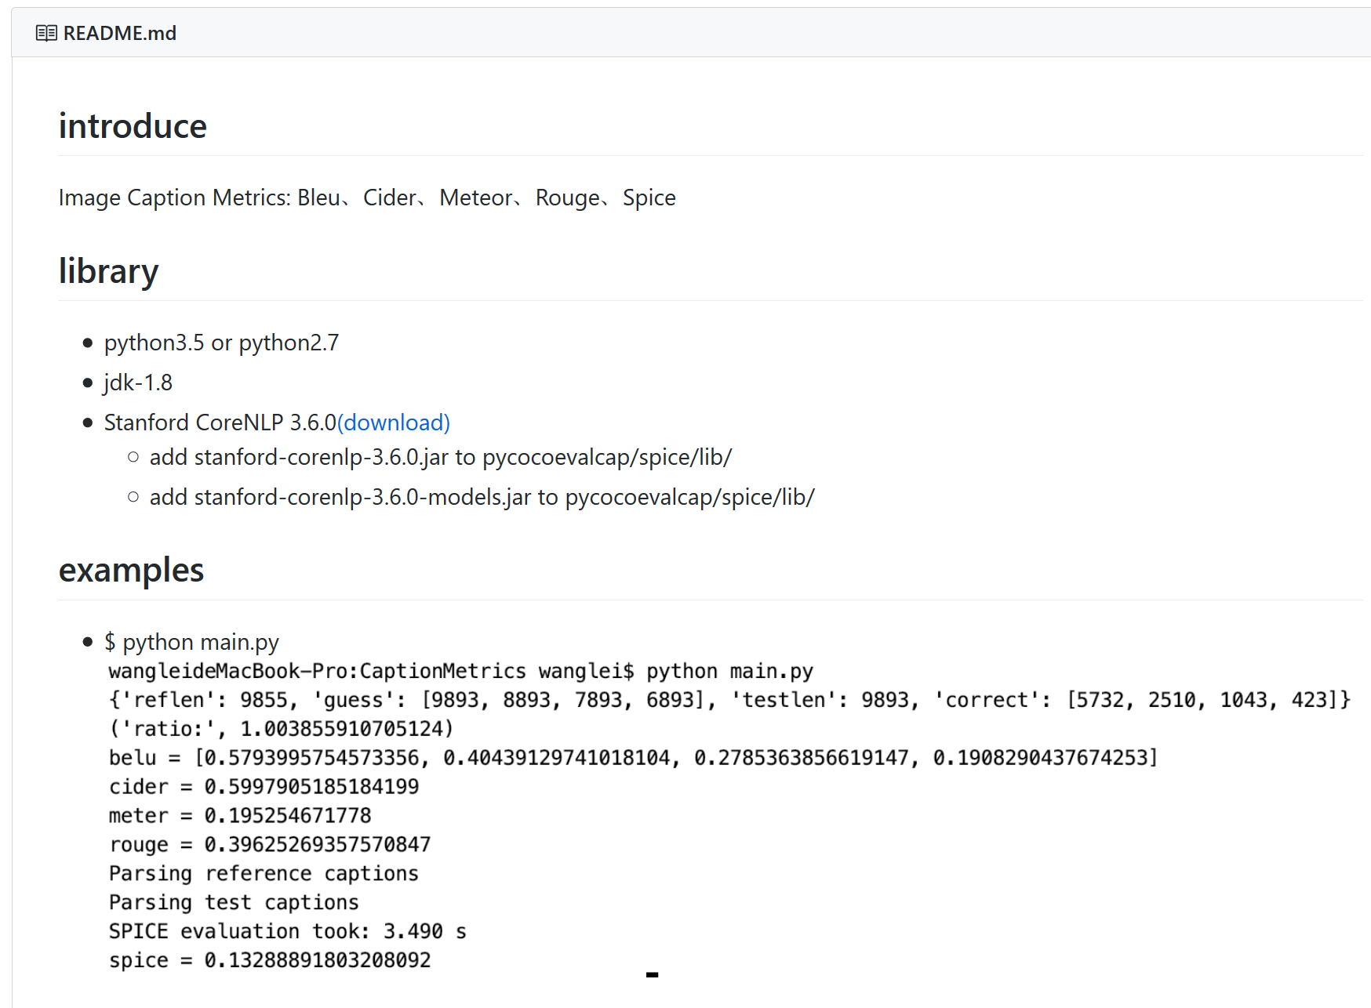
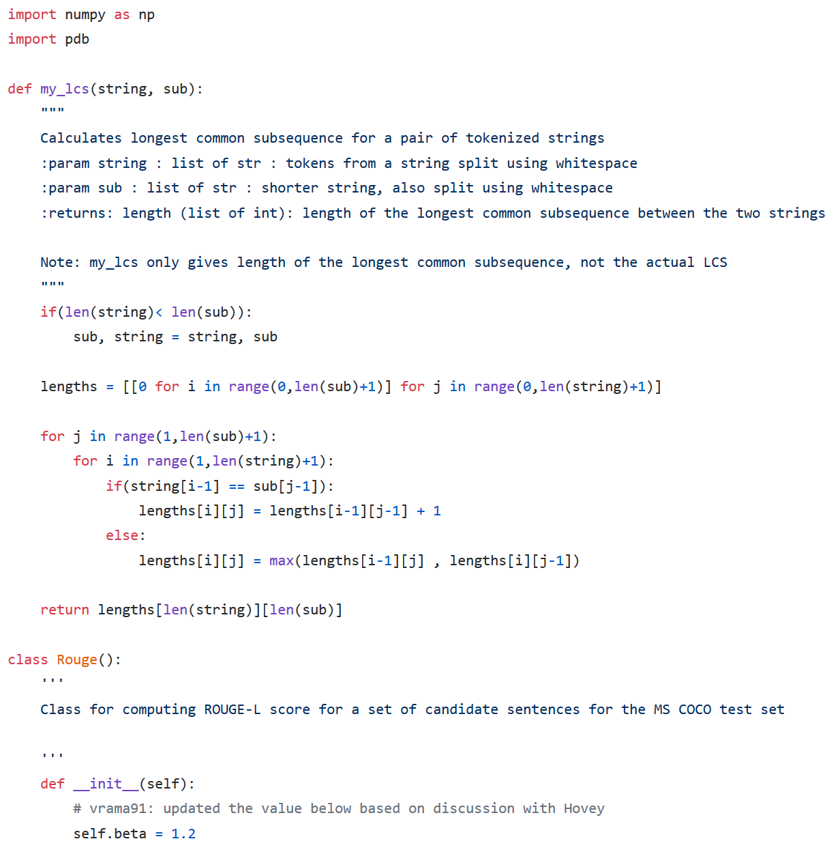
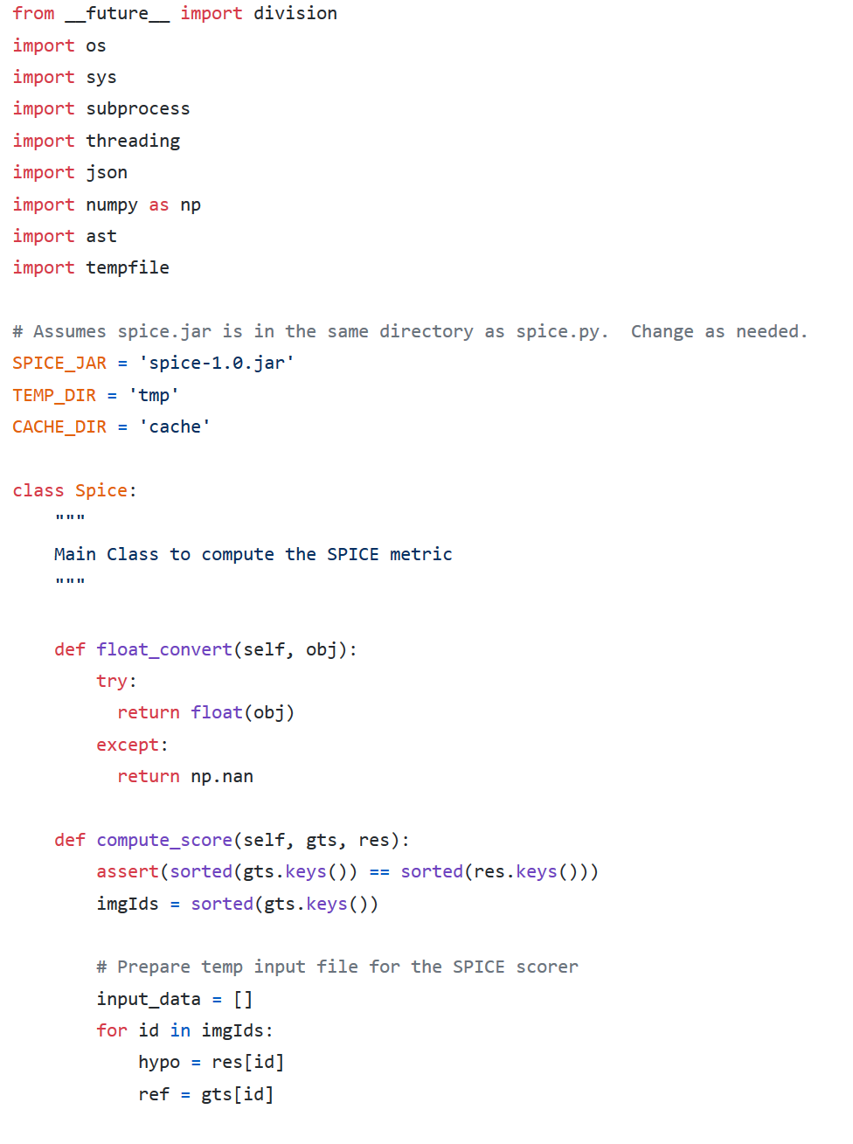
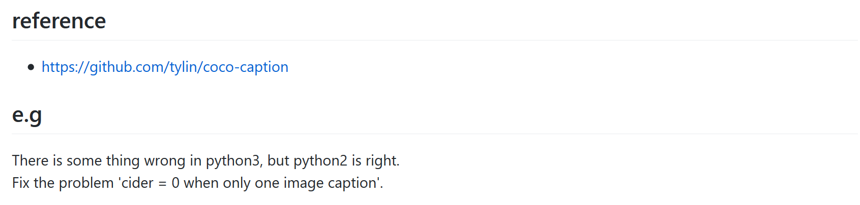
Implementation

